Slide 1
Bee Key
- Btree company -

Slide 2
Table of Contents
01
02
03
Demonstrate
Project statement
06
Software testing
05
Project management
Analysis
and design
04
Software requirement

Slide 3
Project statement
0
1

Slide 4



Problem description
Business finding quality IT resource
Talent student needs online part-time job

Slide 5


Product position
Unlike traditional recruitment
Working online through internet

Slide 6
Product position
Android platform
Running Android 7.0 or higher
Storage size
Free 500MB or higher
RAM size
2GB or higher
Permission
Internet, storage access, etc

Slide 7
Stakeholders
Lancer
Develop team
Banking system
Administrator
Business
Business that needs
IT resources
Lancer who needs
part-time jobs
The BeeKey
develop team
Lecturer
Momo banking system
BeeKey application administrator
Lecturer of the course

Slide 8
Project management
0
2

Slide 9


Team structure
Do Vuong Phuc
Hoang Nhu Thanh
Project manager
Software architecture
Server designer
Process engineer
Business analyst
Software engineer

Slide 10


Team structure
Chung Kim Khanh
Bui Dang Khoa
Software engineer
Software tester
Software engineer
Software tester

Slide 11




Management tools
02
04
Slack
Google tools
01
03
Trello
Github
Communication channel
Other Google tools like Meet, Drive, etc
Task management
Source code management

Slide 12
Management tools
Trello
Backlog
Sprint 0
Sprint 1
Sprint 2
Sprint 3
Sprint 4
Sprint 5
Sprint 6
Task management
Using 7 sprints and 1 backlog lists

Slide 13
Management tools
Backlog
Sprint 0
Sprint 1
Sprint 2
Sprint 3
Sprint 4
Sprint 5
Sprint 6
Sprint
Todo
Doing
Done
Each sprint has: Todo, Doing, Done

Slide 14
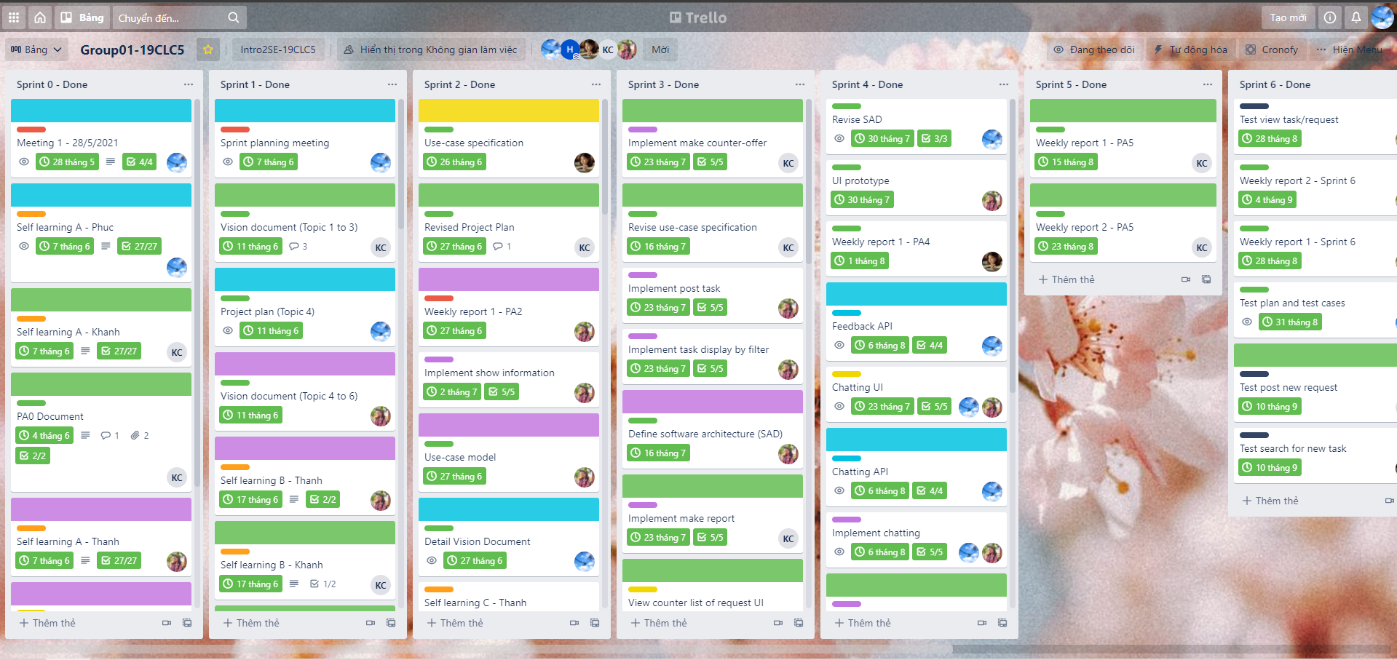
Management tools
Team’s Trello

Slide 15
Management tools
Main
App
Feature A
Feature B
Dev
Server
...
Github branch division

Slide 16
Software requirement
0
3

Slide 17
Usecase – Main flow
Counter-offer
02
01
03
Upload
Accept
Lancer do the counter-offer with the suitable price
Client upload the task
Client accept the counter-offer

Slide 18
Usecase – Main flow
Doing
Feedback
04
06
05
Done
Lancer do the task
Client gives feedback for the lancer
Client accept the solution
The request is done

Slide 19
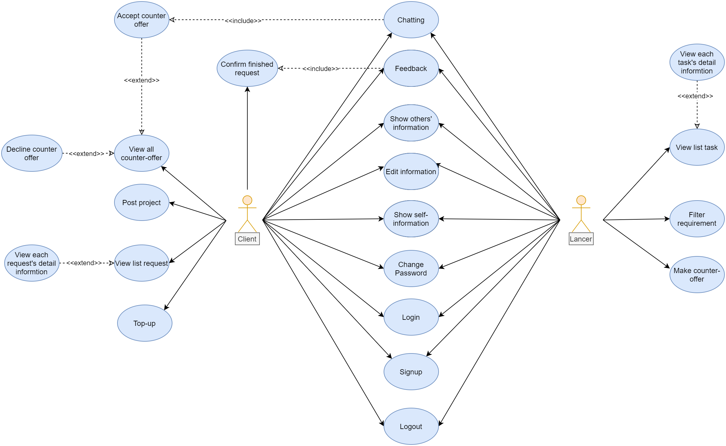
Usecase
Usecase model

Slide 20
Analysis and design
0
4

Slide 21
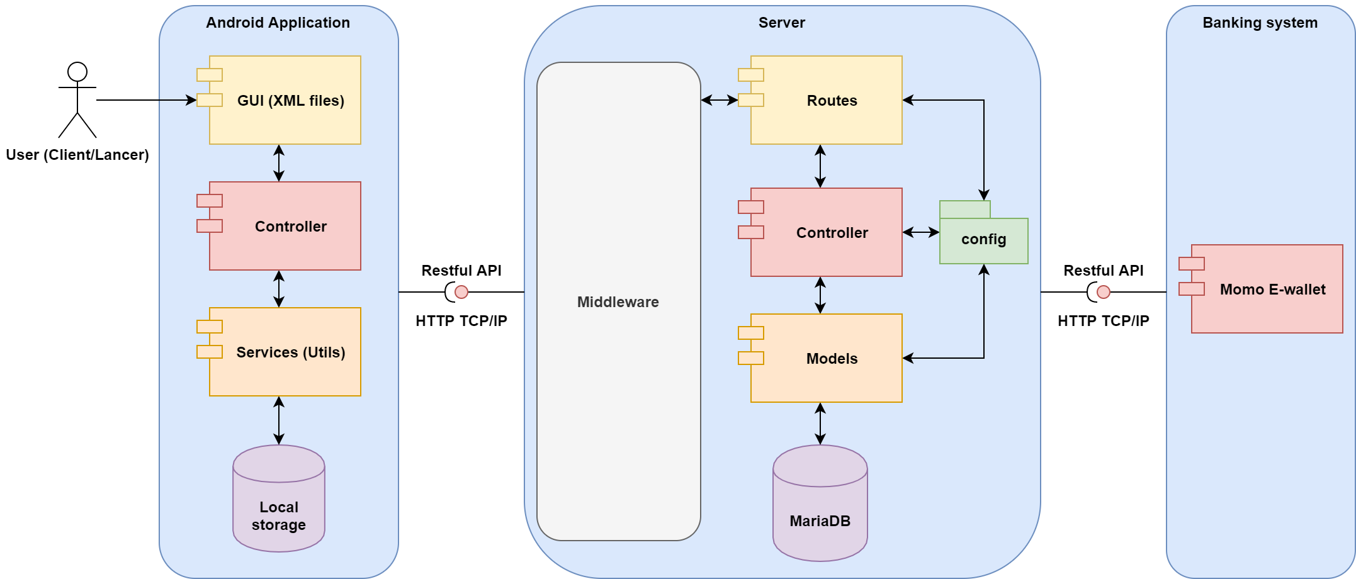
System architecture
Using client-server model and connect through HTTP

Slide 22
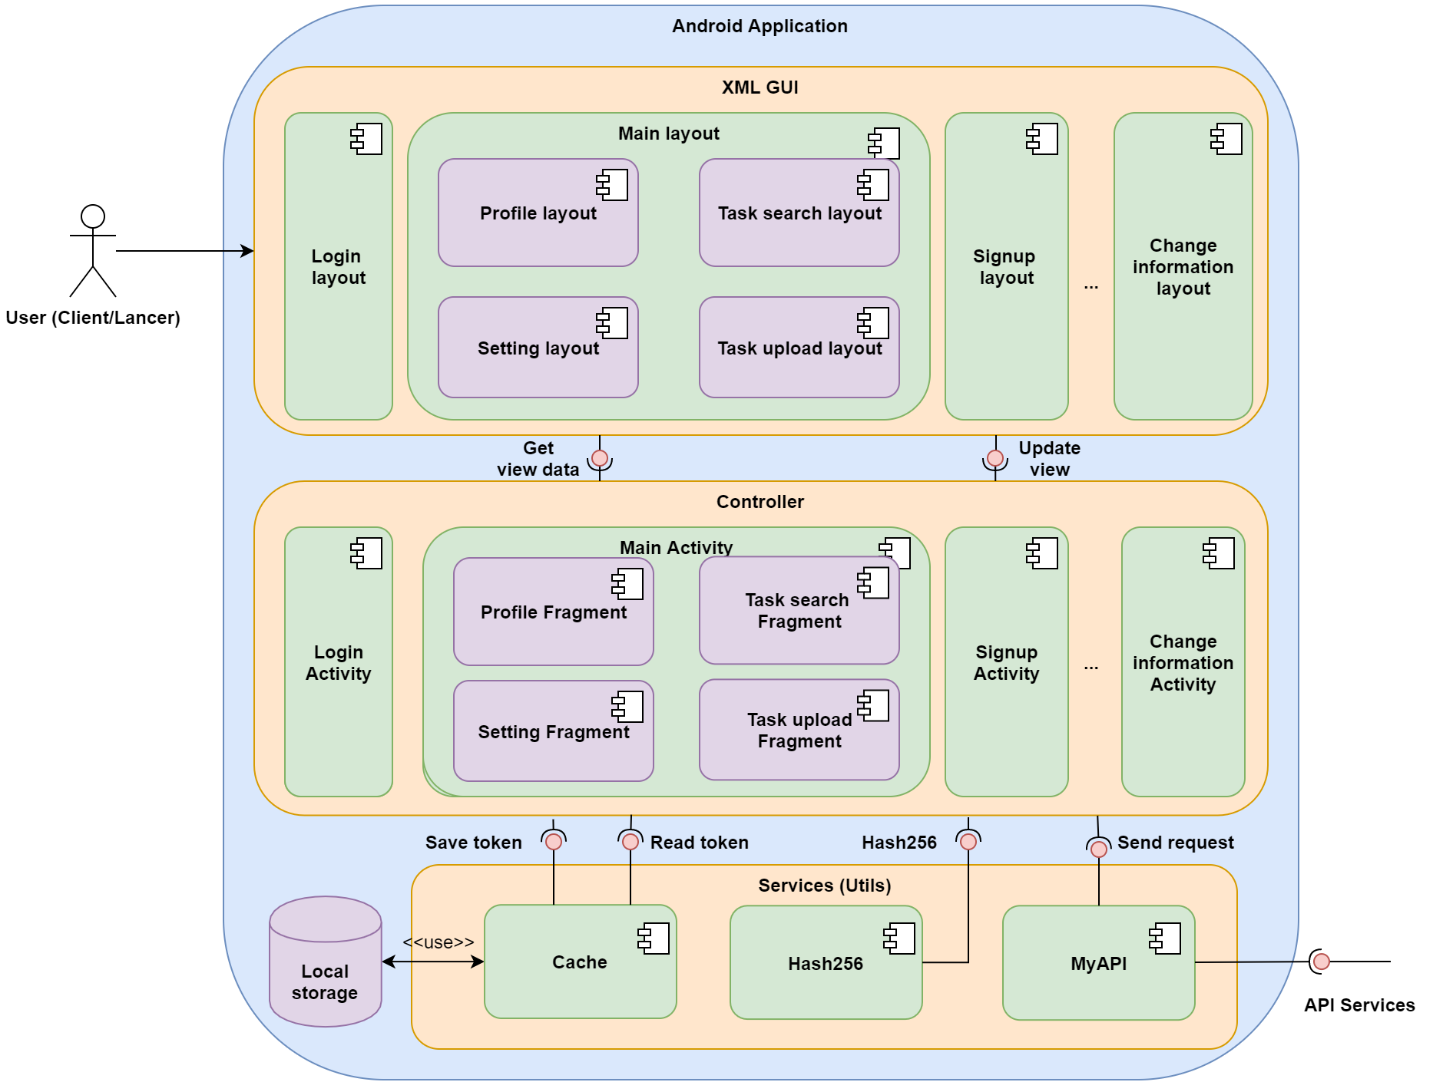
System architecture
Architecture of Android application
Using 3-tiers model:
GUI layer: Views and screens
Controller layer: Process business logic
Services layer: Provide services to connect to server and others

Slide 23
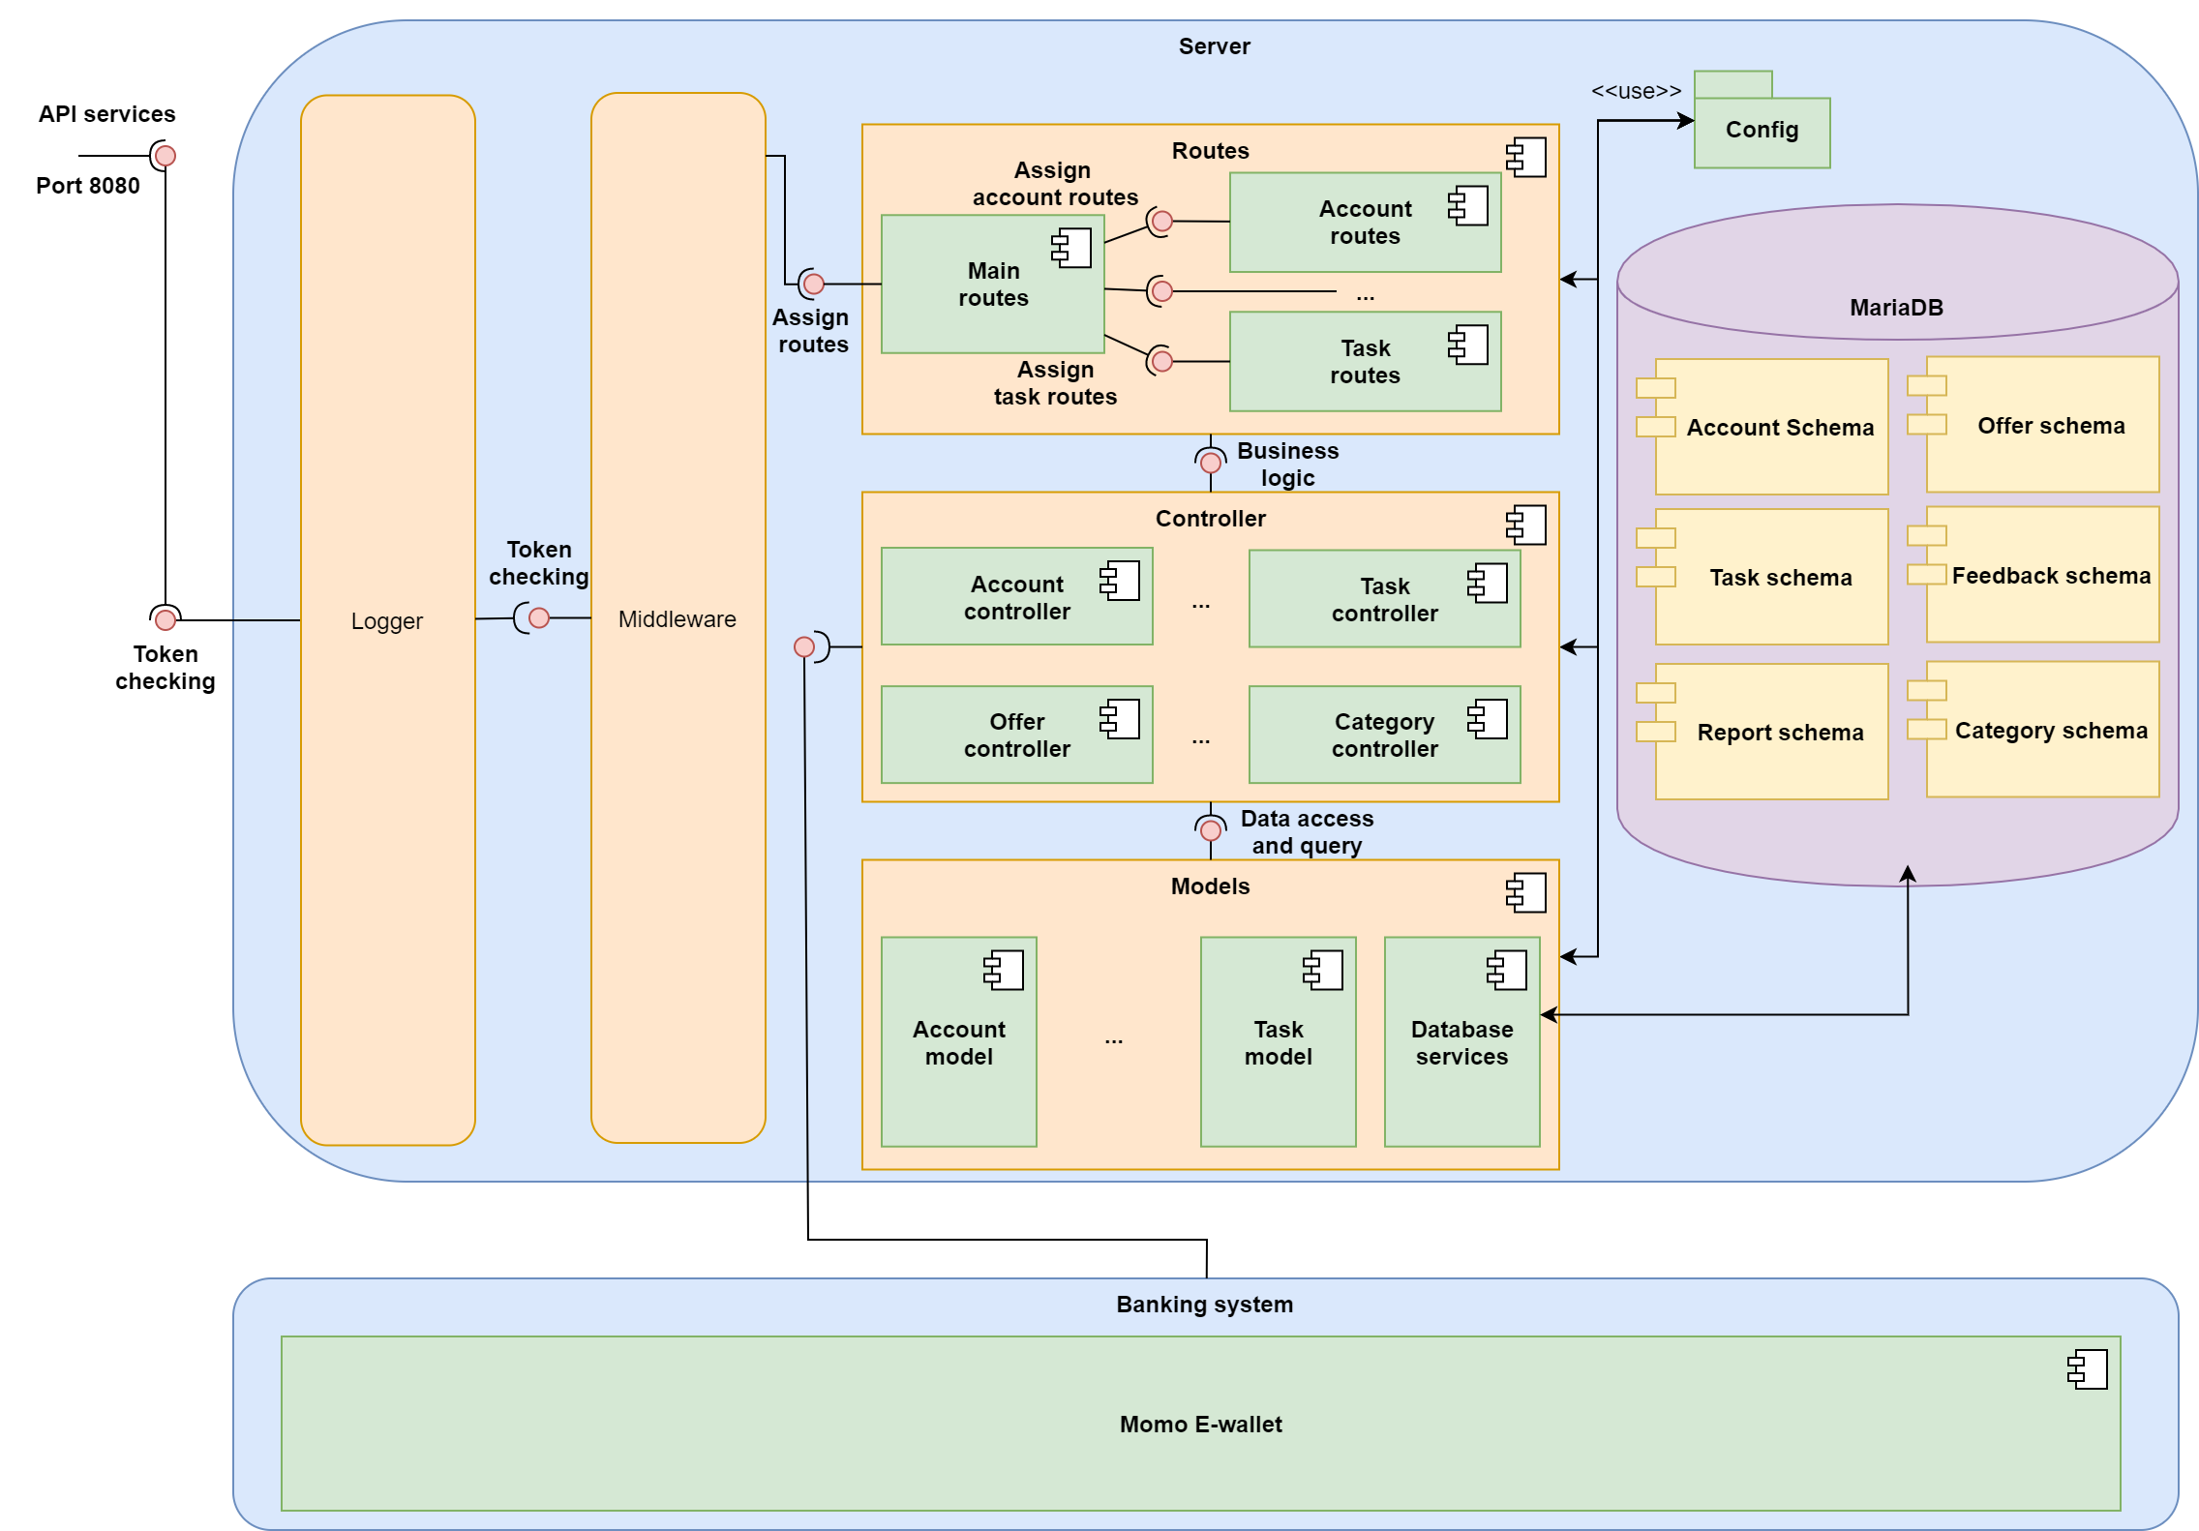
System architecture
Architecture
of Server
Using middleware architecture:
Logger: Log request from client
Middleware: Checking token
Routes: Route the request
Controller: Process business logic
Models: Query, update database

Slide 24
Software Testing
0
5

Slide 25
Testing result
25
12
11
Testcases
Bugs found
Closed bugs

Slide 26
Demonstrate
0
6

Slide 27
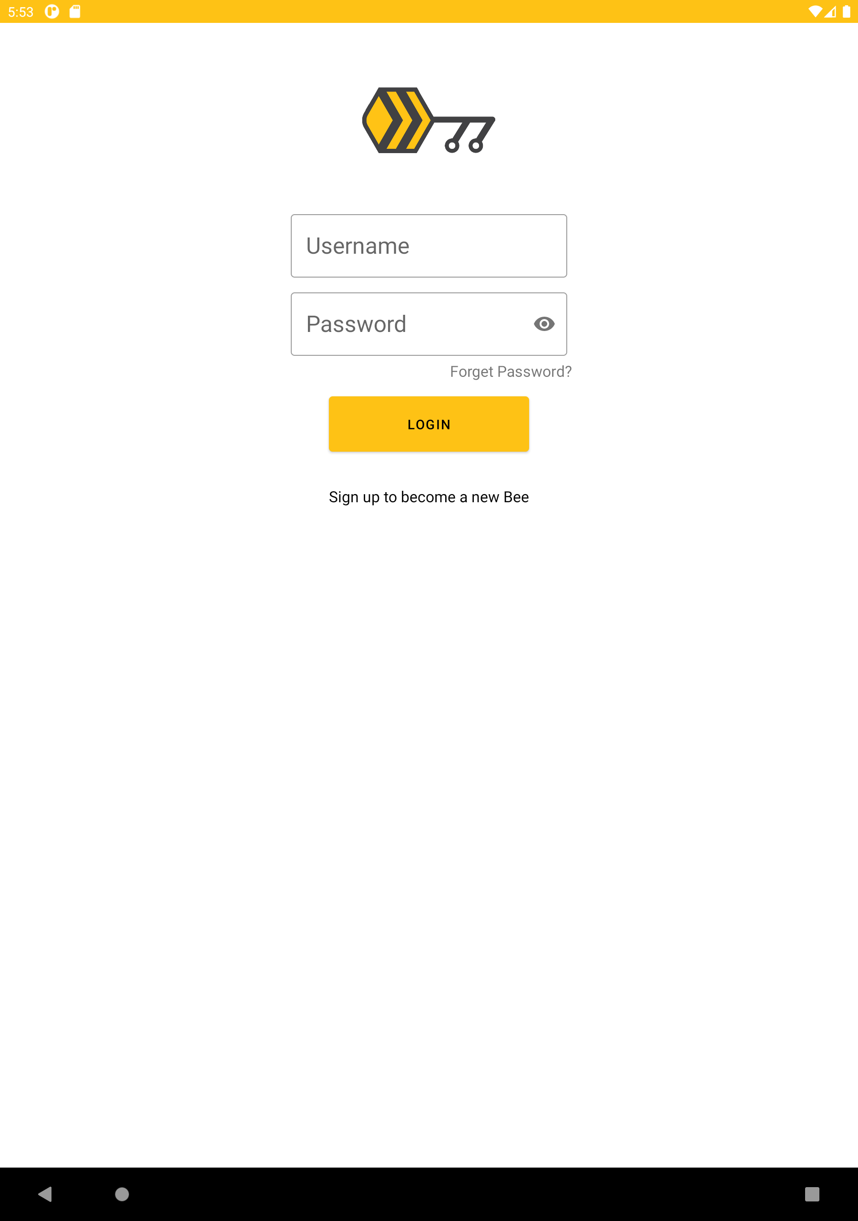
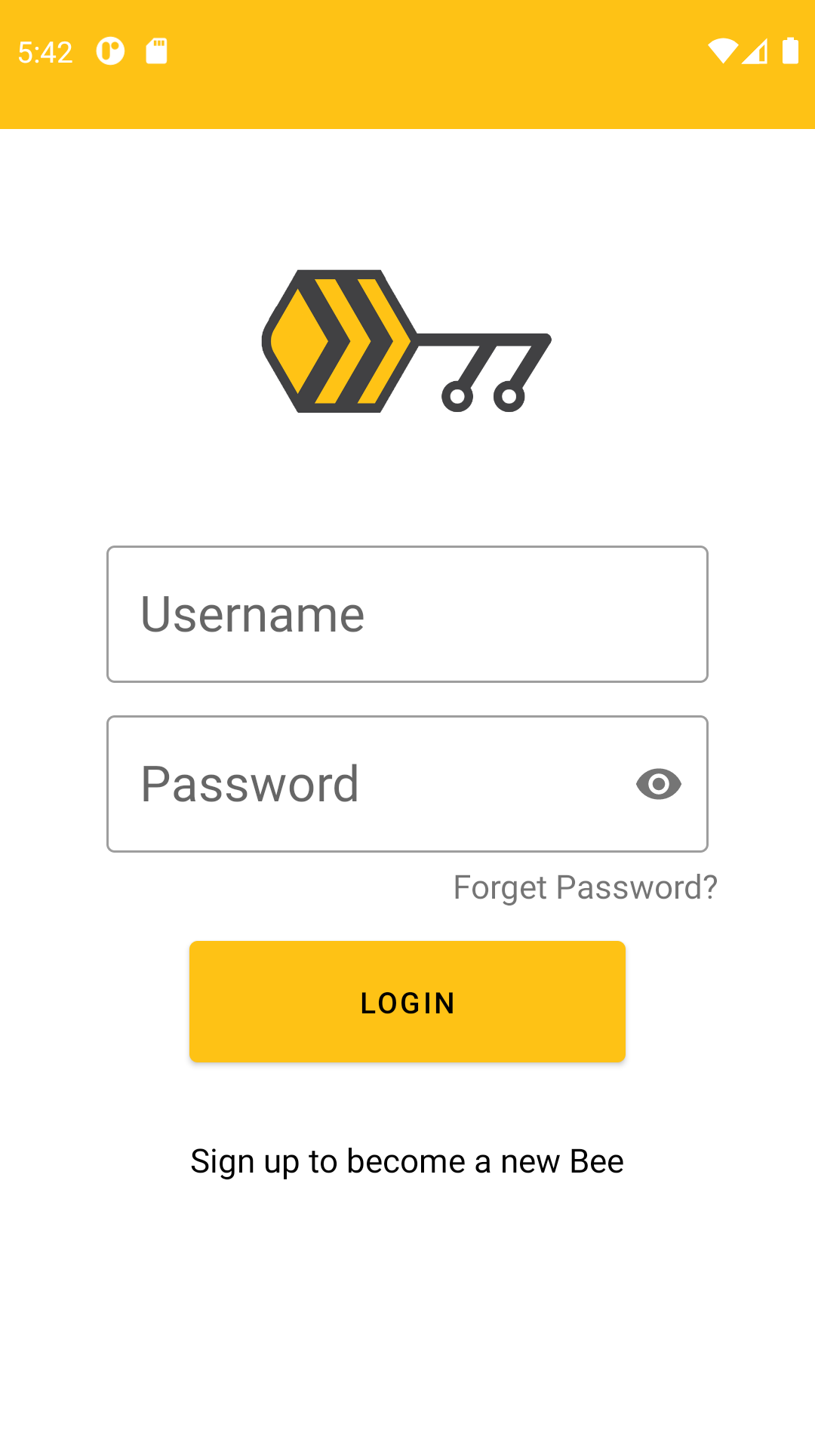
Application

Slide 28
Thanks!
Contact us
19127242@student.hcmus.edu.vn
+84 707 953 475
©BeeKey

